Slide 1

Customer Retention
Presented by
Aamina Ruvaida

Slide 2

E-retail factors for customer activation and retention: A case study from Indian e-commerce customers

Slide 3
Content:
Problem Statement
Why Customer Retention is Important and its Benefit?
Exploratory Data Analysis
Visualization of Data
Conclusion

Slide 4
Problem Statement:
Customer satisfaction has emerged as one of the most important factors that guarantee the success of online store; it has been posited as a key stimulant of purchase, repurchase intentions and customer loyalty. A comprehensive review of the literature, theories and models have been carried out to propose the models for customer activation and customer retention. Five major factors that contributed to the success of an e-commerce store have been identified as: service quality, system quality, information quality, trust and net benefit. The research furthermore investigated the factors that influence the online customers repeat purchase intention. The combination of both utilitarian value and hedonistic values are needed to affect the repeat purchase intention (loyalty) positively. The data is collected from the Indian online shoppers. Results indicate the e-retail success factors, which are very much critical for customer satisfaction.

Slide 5
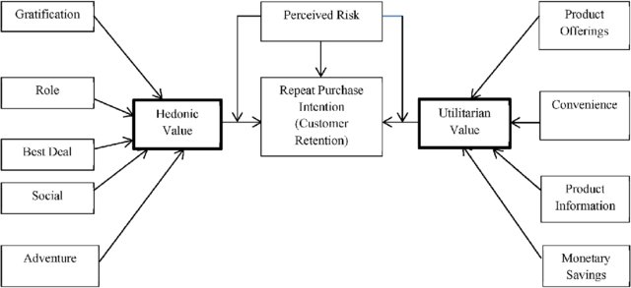

Slide 6
What is Customer Retention?
Customer retention is a company’s ability to turn first-time customers into repeat buyers and prevent them from switching to a competitor. It indicates the quality of a product or service and the degree of customer loyalty. Retention is best achieved by overcoming barriers to switching, maximizing the value of products and services, meeting customer expectations, and enriching the customer experience.
Why Customer Retention is Important?
Customer retention starts with the first interaction any customer has with a business and continues throughout the entire lifetime of a relationship with that business. Successful customer retention takes the entire customer lifecycle into account. A company’s ability to attract and then retain new customers is related not only to the product or service they offer, but also how they service their customers, the value their customers perceive because of using their services and the reputation their brand holds across the market.
.

Slide 7
What are the Customer Retention Benefits?
Retention is Cheaper than Acquisition
Loyal Customers are More Profitable
Your Brand Will Stand Out from the Crowd
You’ll Earn More Word of Mouth Referrals
Engaged Customers Provide More Feedback
Customers Will Explore Your Brand
Loyal Customers are More Forgiving
Customers Will Welcome Your Marketing
It's Better for Employee Health
To Increase Retention, Increase Engagement

Slide 8
Exploratory Data Analysis:
There are 269 rows and 71 columns
We have replace the Missing value with mode if is categorical data. Replace with Median if it is numerical data.
We have use various plots to visualize the data.
There are 70 object data type, we convert object data type to integer or Float using Label Encoder.

Slide 9
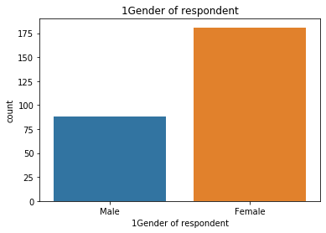
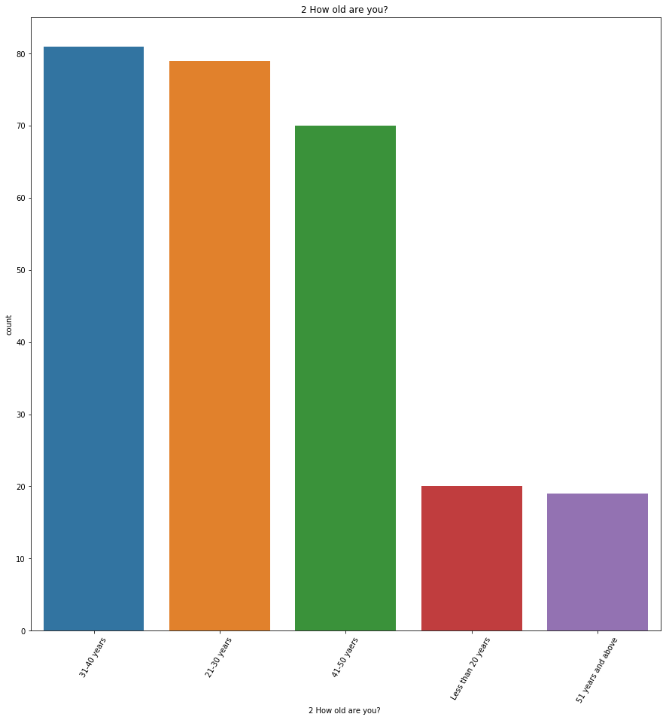
Exploratory Data Analysis:
Majority of Customer are Female.
Female count is 181 and male count is 88
Majority of customer lies in the range of age 31-40 years.

Slide 10
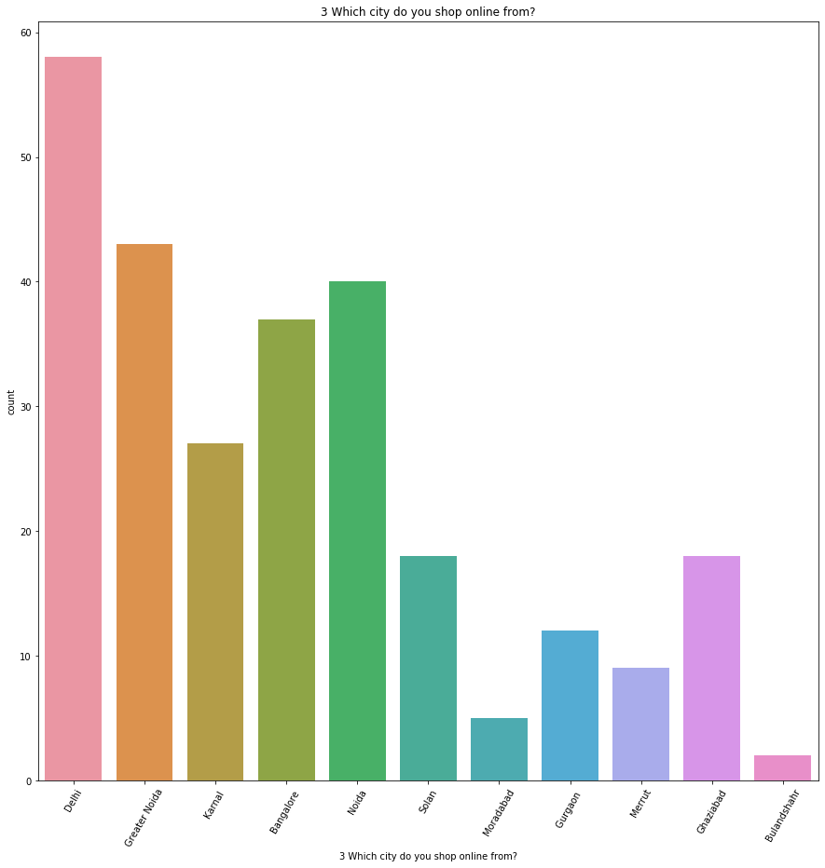
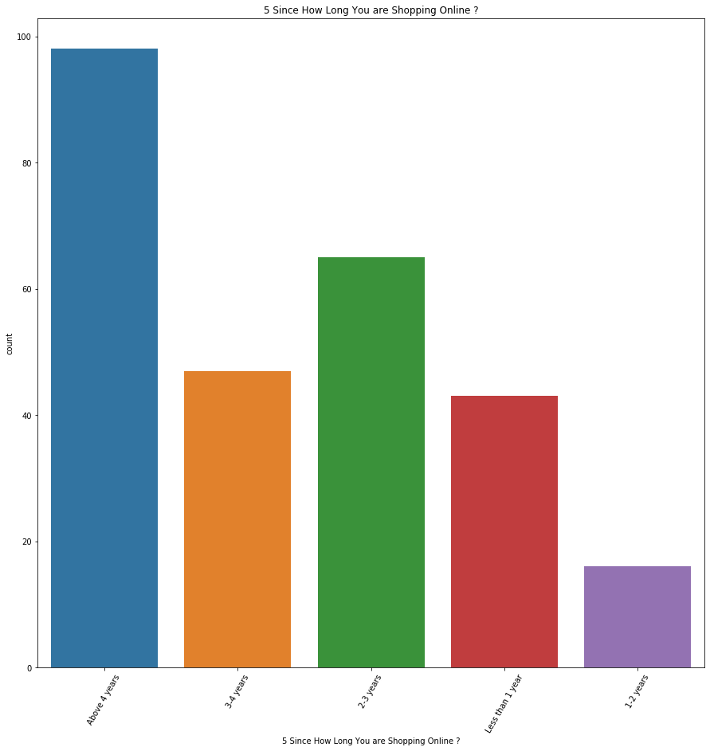
Majority of customers are from Delhi.
Customer from Delhi are purchasing more as compare to other country.
Customer are purchasing through online are more than 4 years.

Slide 11
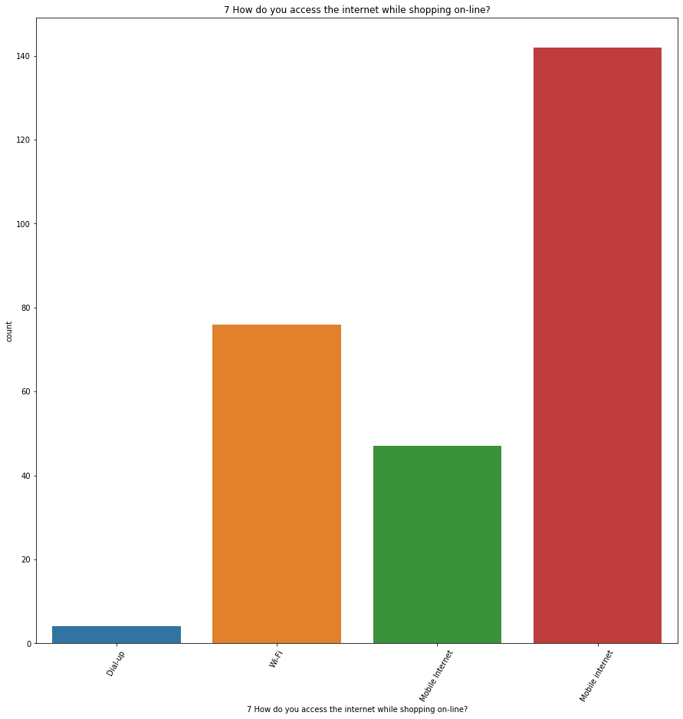
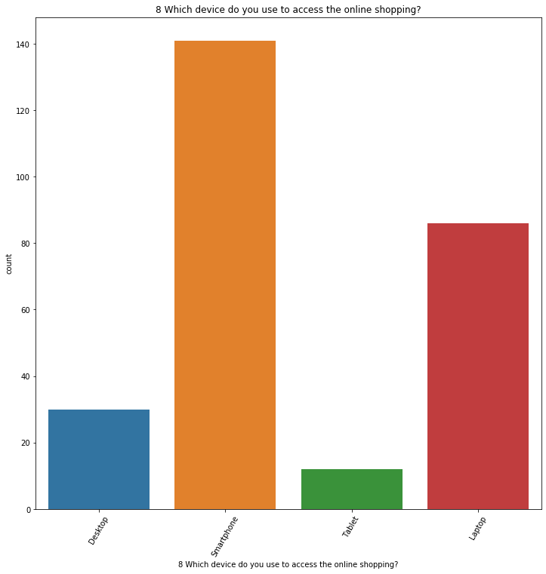
Majority of customers are using Mobile Internet to purchase items in Online.
Majority of customers use Smart phone for Online shopping.

Slide 12
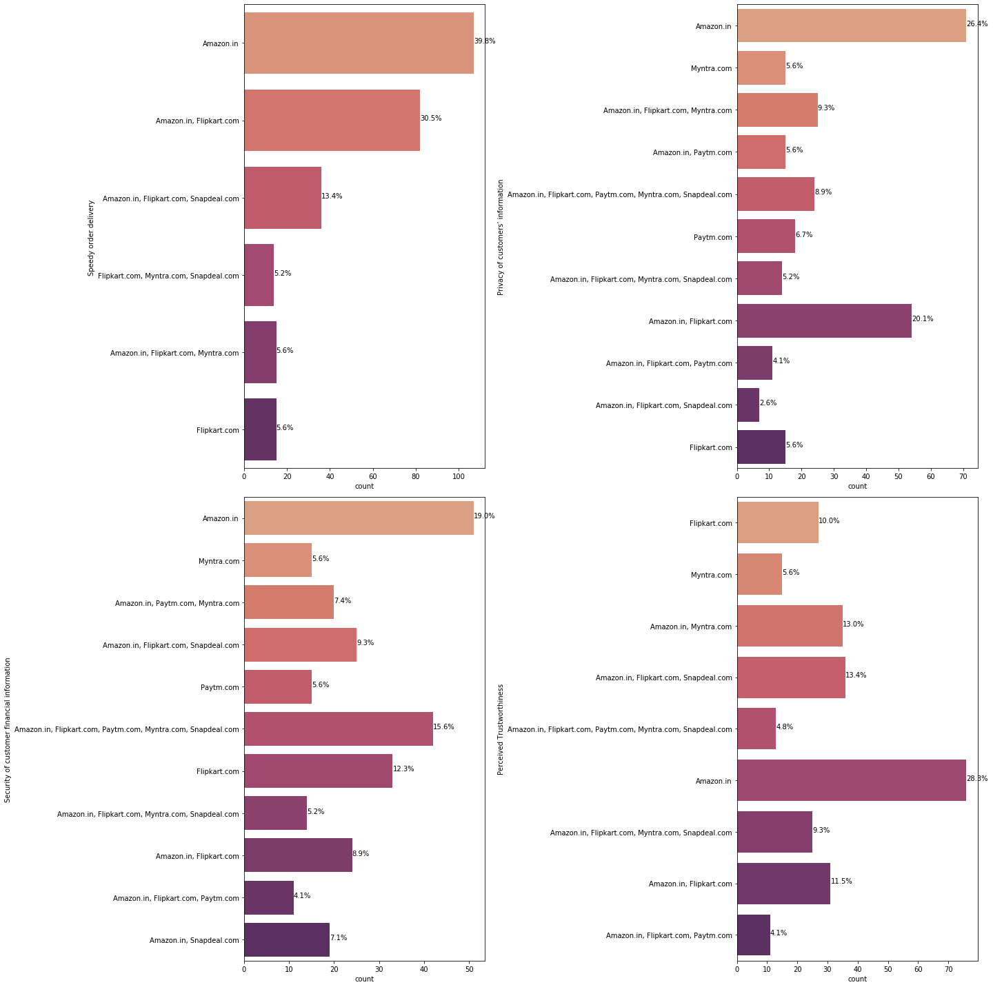
Majority of Customer prefers to do Online Shopping in Amazon.
After Amazon it comes Flip Kart.
Customers are well satisfied with the service provided by Amazon.

Slide 13
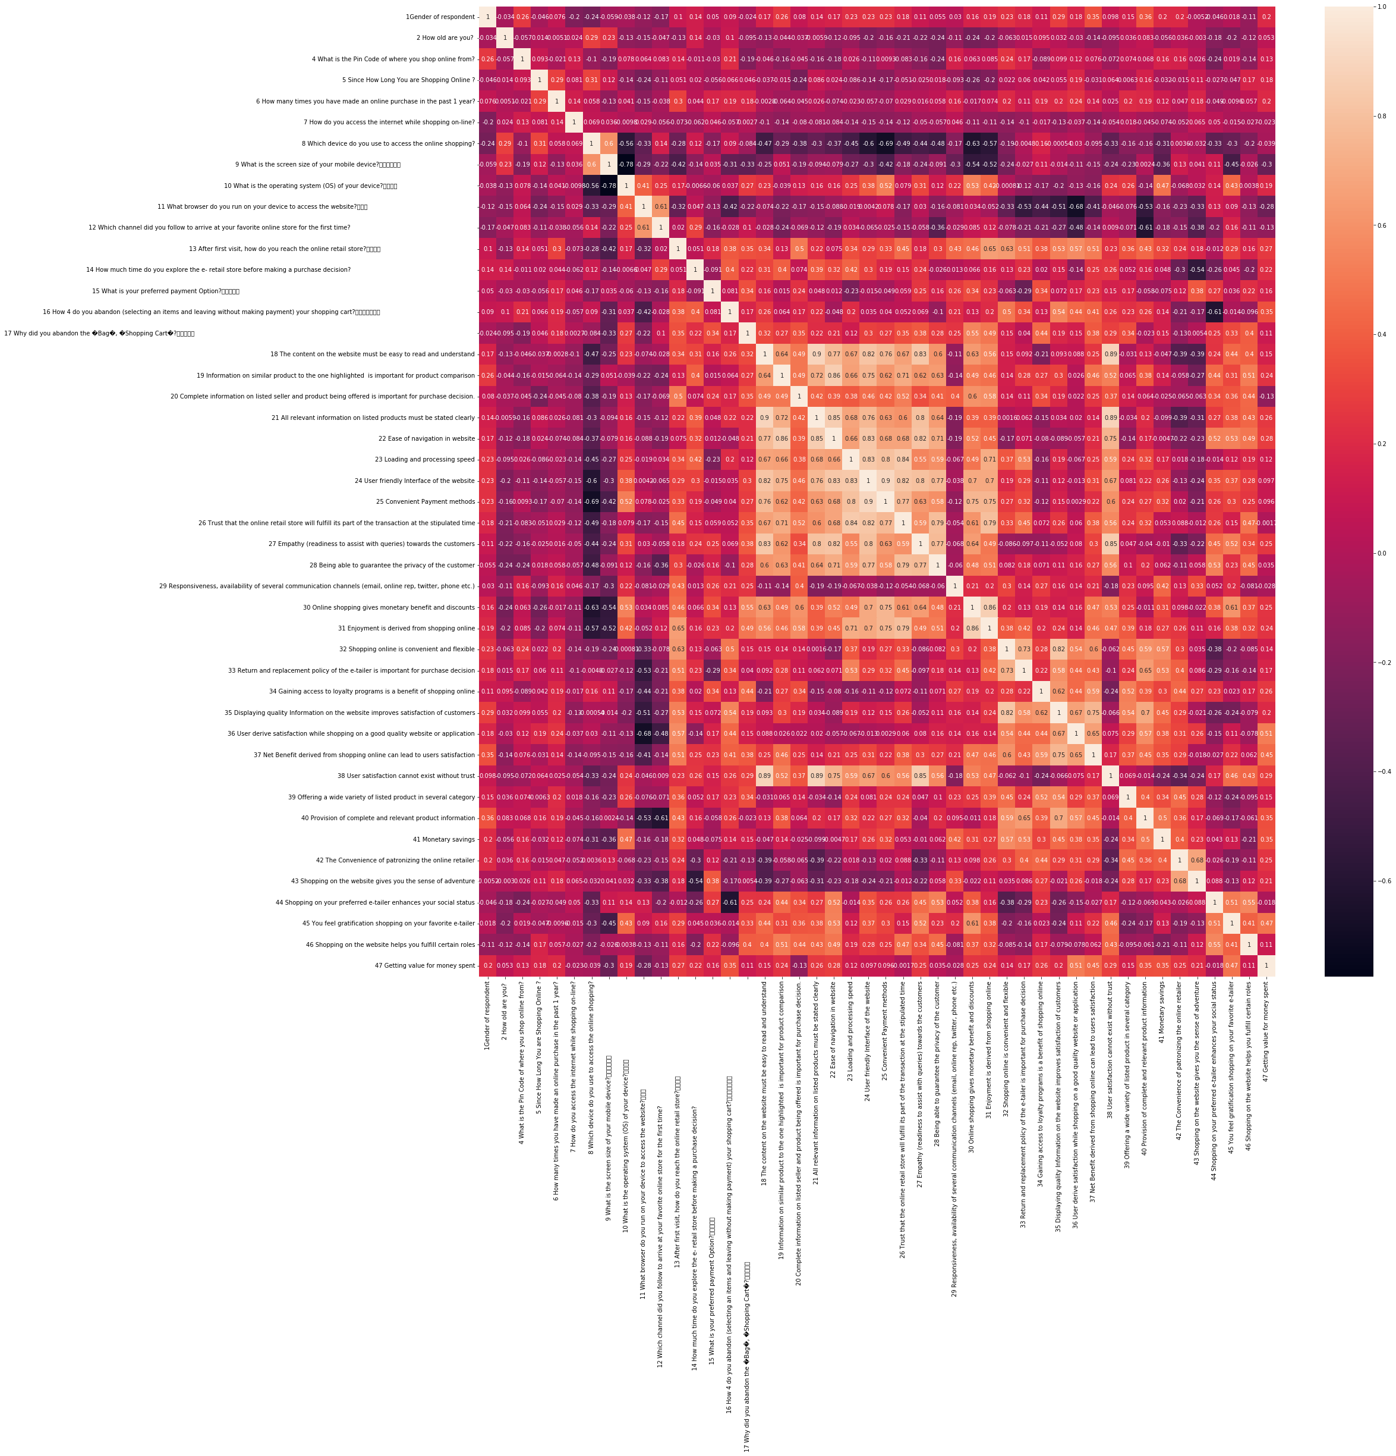

Slide 14
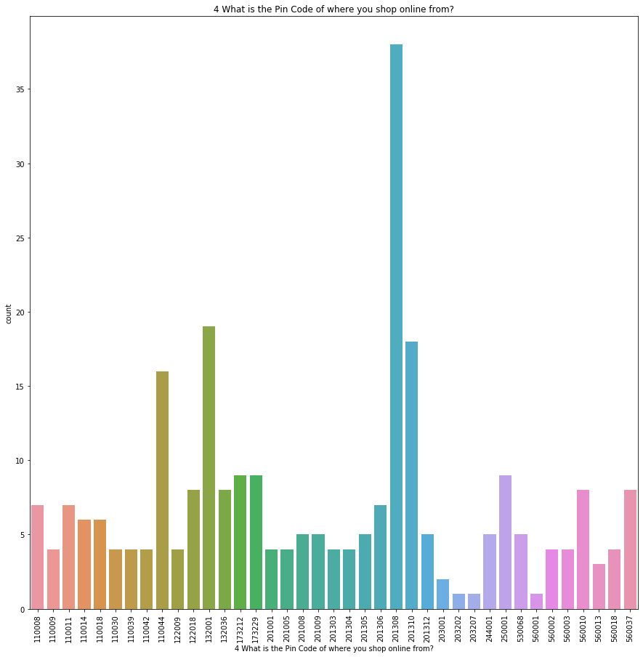
Majority of Customers are shopped by the Pin code 201308

Slide 15
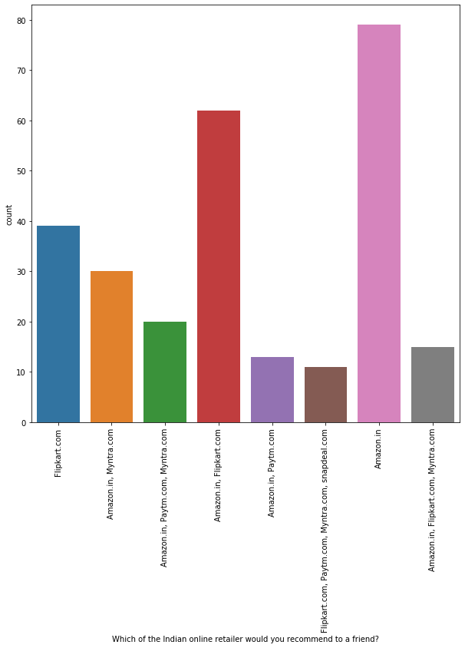
Amazon.in | 79
Amazon.in, Flipkart.com | 62
Flipkart.com | 39
Amazon.in, Myntra.com | 30
Amazon.in, Paytm.com, Myntra.com | 20
Amazon.in, Flipkart.com, Myntra.com | 15
Amazon.in, Paytm.com | 13
Flipkart.com, Paytm.com, Myntra.com,, snapdeal.com | 11
Majority of Customer is purchasing from Amazon.
Amazon count is the highest among all other shopping website.

Slide 16
Conclusion:
In Customer review, majority of customer recommend Amazon to friend. Then comes next Flipkart. Least visiting customer website is Paytm.
Amazon is recommended by 81.4% of the customers.
· Snapdeal is recommended by 4.1% of the customers.
· Flipkart is recommended by 47.2 of the customers.
· Myntra is recommended by 28% of the customers.
· Paytm is recommended by 16% of the customers
In final conclusion we came to know that majority of customer recommends Amazon to friends.
Amazon provides a good service, fast delivery, 24/7 Customer support team available to help customer queries. Multiple channel available to connect with support team to get the instant resolution. Customer can connect via phone, email or chat support.
Amazon provides best deal offer, discount for special vocation. It provides variety of games to win the abandoned of prizes. Which gives the customer to retain for longer.

Slide 17
Amazon interface is friendly and easy to use. It allows the customers to return the product or cancel the product at any time without any charge.
It provide wide range of product availability in each category. In Festive occasion more product are visible in the Amazon page related to that occasion.
It has build a strong customer relationship and trust.
Customers are well satisfied with Amazon. People from across the world are purchasing through Amazon.
By doing the research I understand various aspect of Customer Retention. I learned how to plot the graph, chart and subplots. Done the correlation, removing the missing value, Learned how to replace the missing value. This project gives a good insight to understand the Customer requirement, what makes any business to grow. It also provide a good knowledge on how to grow the business. When customer is satisfied with our product. Our business with automatically grow on it own.
By doing EDA, learned how to manage the unrealistic data. How to convert the categorical data to numerical data. Overall it was a good experience in analysis Customer Retention project.

Slide 18


